Slide 1
Light: its nature and its properties
Lecturer: Mauro Mosca
(www.dieet.unipa.it/tfl)
last update: 01/10/2021
University of Palermo – Master in Electronic Engineering

Slide 2
Overview
Waves
Dual nature of light
Light properties
Refractive index
Interference
Photoelectric effect
Electromagnetic spectrum
Dispersion
Gratings
Spectrometers
Polarizers
Optical modulators

Slide 3



Waves
Longitudinal waves
Transversal waves

Slide 4
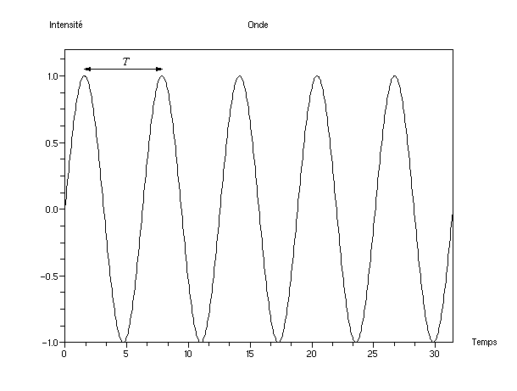
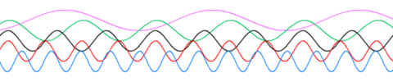
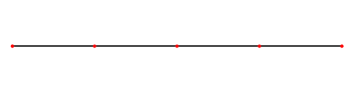
Frequency and wavelength
Not all waves travel…
…at a fixed point in space
standing waves

Slide 5
Frequency and wavelength
λ
λ/T = λf = v

Slide 6




Light
Waves
or
particles
?
+
reflection, refraction
shadows
Electromagnetic and quantum theory are in perfect agreement if we assume that the amplitude of a field (electric or magnetic) at a certain point and at a certain instant is proportional to the probability (wave function) of finding a photon

Slide 7
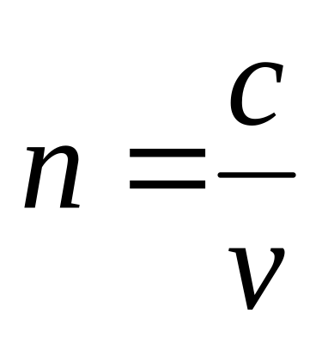
Light properties
Reflection
θ_{i}
θ_{r}
θ_{i} = θ_{r}
n₁
n₂
θ_{t}
n₁sinθ_{i} = n₂sinθ_{t}
Refraction

Slide 8
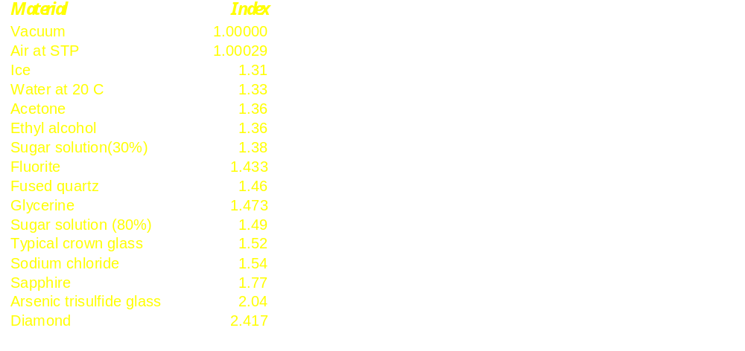
Refractive indices

Slide 9


Why refraction?
n₁ = 1
?
n₂ = 1,3

Slide 10
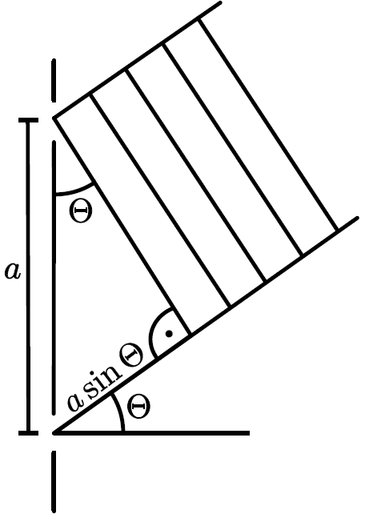
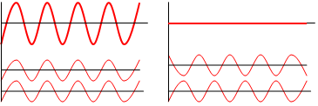
Interference: some pretty simple math...
asinθ = nλ
asinθ = (n+1/2)λ

Slide 11
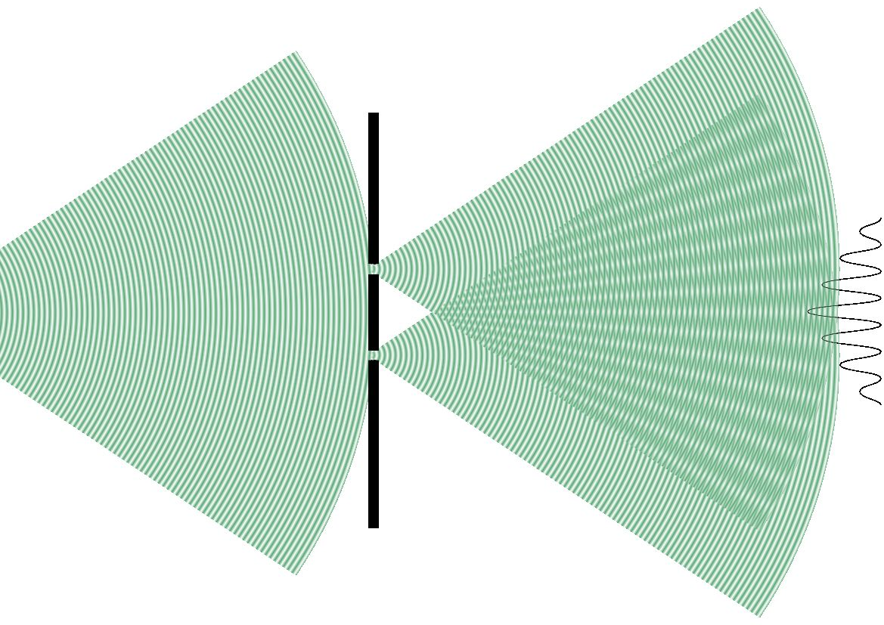

Web project:
ngsir.netfirms.com

Slide 12
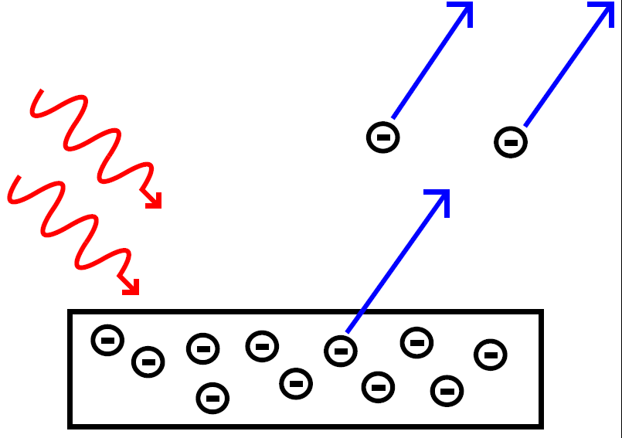
Photoelectric effect
both velocity and energy of electrons independent of light intensity
both velocity and energy of electrons dependent on color of light
electrons insensitive to some colors

Slide 13
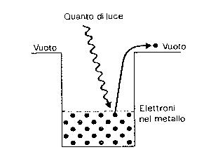
Photons
photons
Light = “energy packets”
E = hf = hc/λ (Planck-Einstein relation)

Slide 14
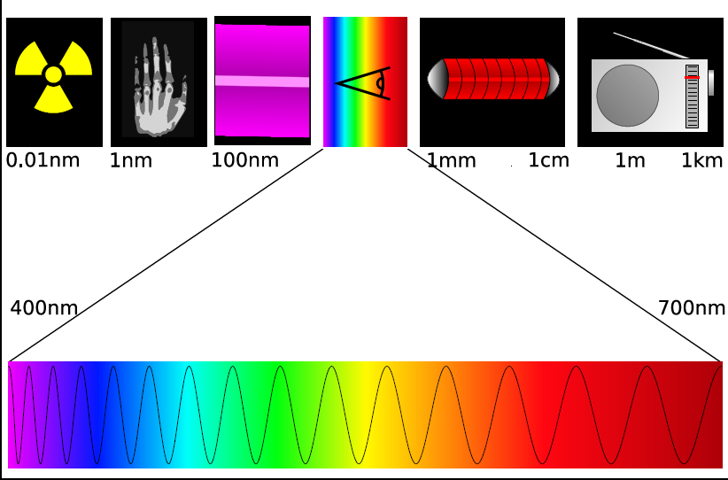
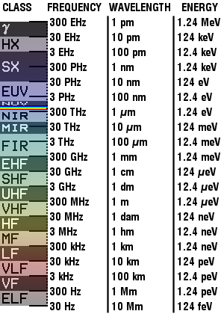
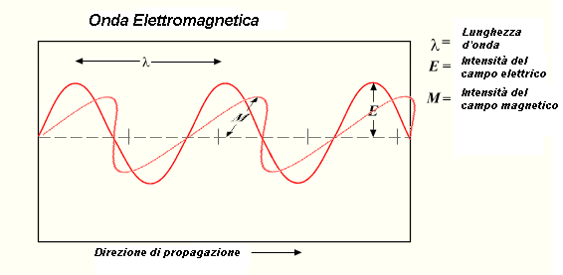
Electromagnetic spectrum

Slide 15
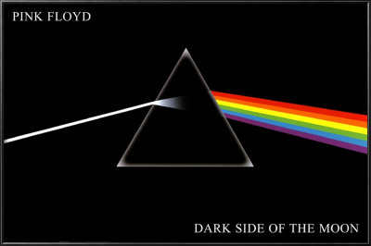
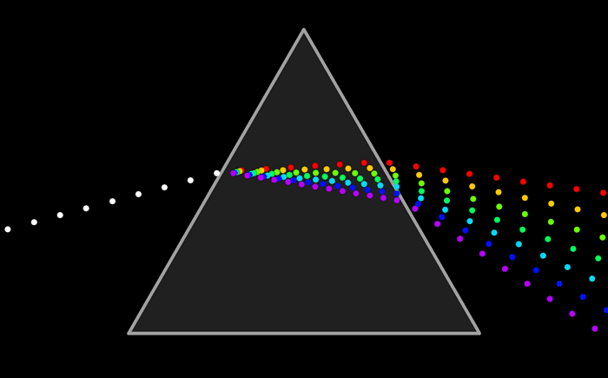
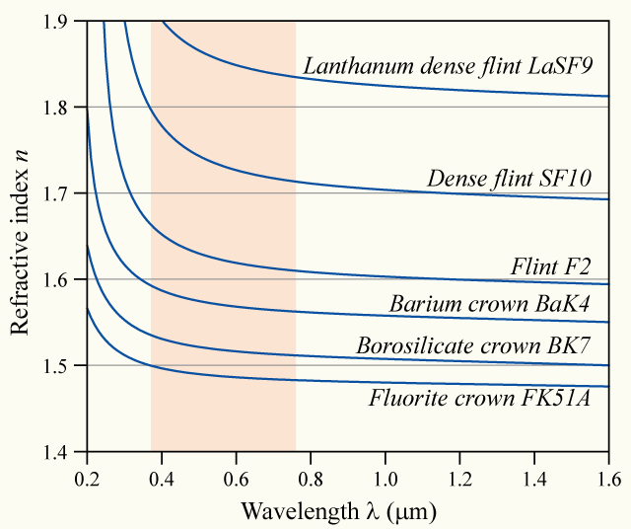
Dispersion
n = n (λ)
v function of λ

Slide 16

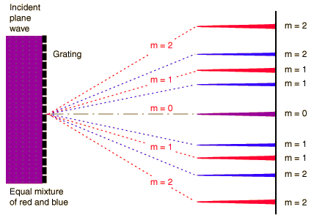
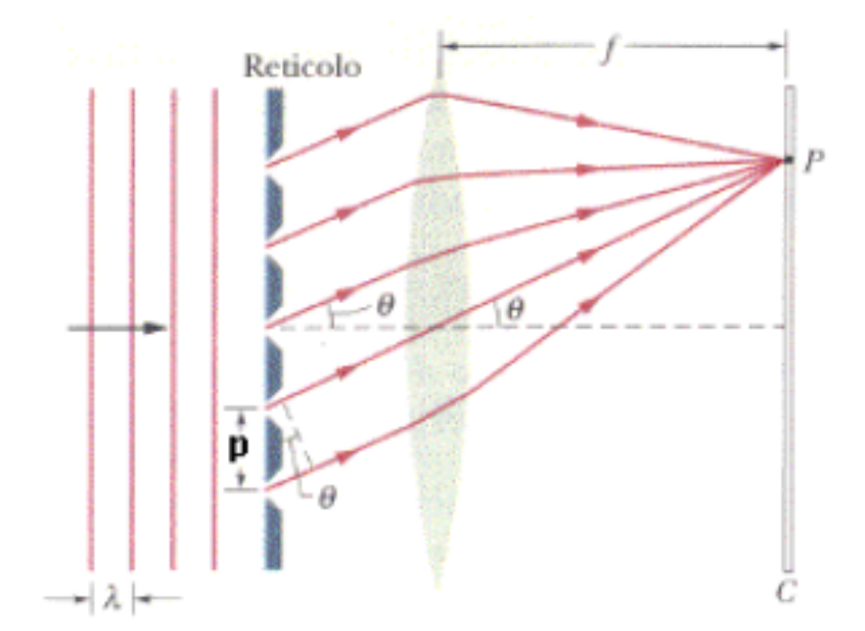
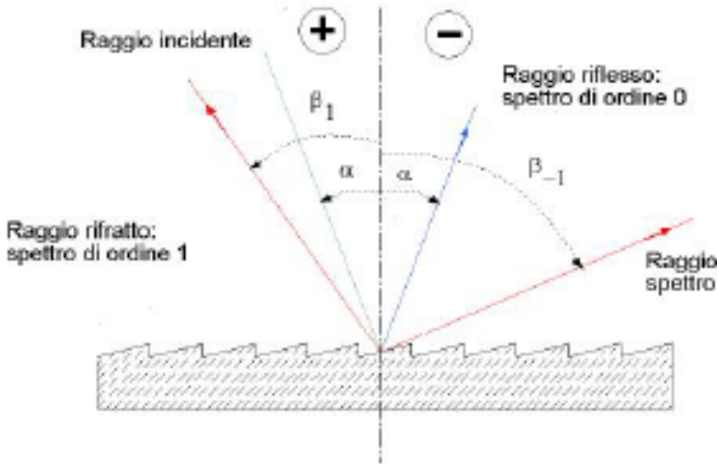
Gratings
in trasmission
in reflection
ordine 1
asinθ = nλ

Slide 17
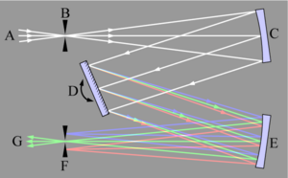
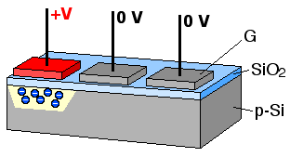
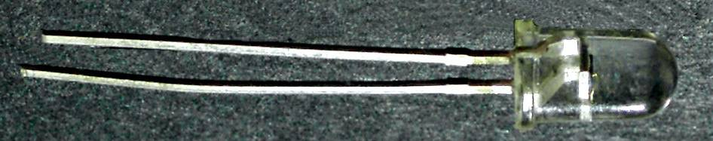
Spectrometer
mirrors
slit
resolution?…

Slide 18
Polarization of light
E
polarized light
H
non-polarized
light

Slide 19
Polarizers
E
Web project:
ngsir.netfirms.com

Slide 20
Optical activity
ability of some crystals to rotate the wave
polarization plane
electric field E
n_{y}
possible in crystals that exhibit
birefringence
n_{x}
electro-optic effect

Slide 21
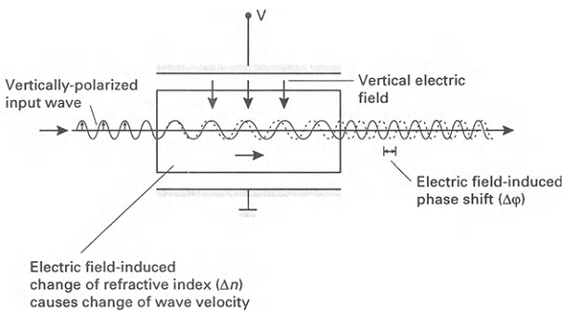
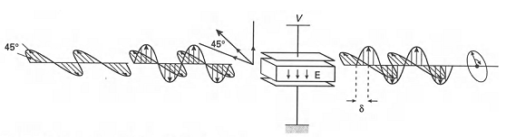


Light modulation

Slide 22
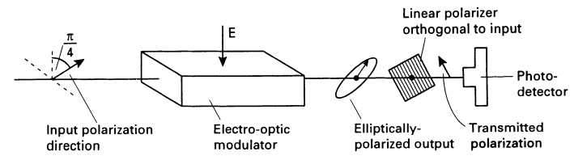
Light modulation: amplitude modulation
= f(t)

